Slide 1
Chapter 1 part 2
Introduction
Data Structure and Algorithm

Slide 2
Pseudo-code
Informal language used to present algorithms.
Pretty close to English but precise enough for a computing agent to carry out.
High-level description of an algorithm
More structured than English prose
Less detailed than a program
Preferred notation for describing algorithms
Hides program design issues

Slide 3
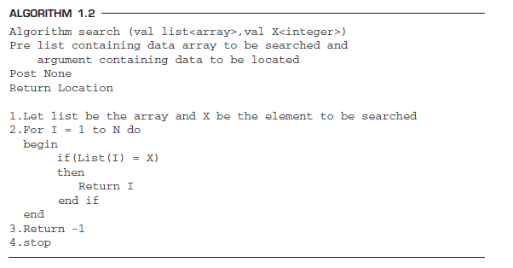
header

Slide 4
Example: find max element of an array
Algorithm arrayMax(A, n)
Input array A of n integers
Output maximum element of A
currentMax ← A[0]
for i ← 1 to n − 1 do
if A[i] > currentMax then
currentMax ← A[i]
return currentMax

Slide 5
Pseudocode Details
Control flow
if … then … [else …]
while … do …
repeat … until …
for … do …
Indentation replaces braces
Method declaration
Algorithm method (arg [, arg…])
Input …
Output …
Method/Function call
var.method (arg [, arg…])
Return value
return expression
Expressions
Assignment (linoe = in C++)
Equality testing (linoe == in C++)
n² Superscripts and other mathematical formatting allowed

Slide 6

Algorithm 2
Algorithm 1
Algorithm 3
Which one to choose ?
Problem
Algorithm 5
Algorithm 4
Algorithm 7
Algorithm 6

Slide 7
Algorithm Complexity Analysis
How can we identify most efficient algorithm ?
predicting the resources that the algorithm requires
Time complexity: the amount of time taken by an algorithm to run as a function of the length of the input.
Space complexity: the amount of space or memory taken by an algorithm to run as a function of the length of the input.
Time/Space TRADE OFF :- we may have to sacrifice one at the cost of the other
Time and space complexity depends on …. Hardware, OS, processors ..etc
We only consider the execution time of an algorithm.
Notes:
Analyzing an algorithm has come to mean predicting the resources that the algorithm
requires. Occasionally, resources such as memory, communication bandwidth,
or computer hardware are of primary concern, but most often it is computational
time that we want to measure.

Slide 8
Cont.…
Efficiency of an algorithm can be analyzed at two different stages, before implementation and after implementation.
A Priori Analysis − This is a theoretical analysis of an algorithm.
Efficiency of an algorithm is measured by assuming that all other factors, for example, processor speed, are constant and have no effect on the implementation.
A Posterior Analysis − This is an empirical analysis of an algorithm.
The selected algorithm is implemented using programming language.
This is then executed on target computer machine.
In this analysis, actual statistics like running time and space required, are collected.

Slide 9
Space complexity
Analysis of space complexity of an algorithm or program is the amount of memory it needs to run to completion.
Some of the reasons for studying space complexity are:
To avoid failure/crash of algorithm after we implement it due to memory overflow
We may be interested to know in advance that whether sufficient memory is available to run the program.
There may be several possible solutions with different space requirements.
Can be used to estimate the size of the largest problem that a program can solve

Slide 10
Time Complexity
The time complexity of an algorithm or a program is the amount of time it needs to run to completion.
The exact time will depend on
the implementation of the algorithm, programming language, optimizing the capabilities of the compiler used, the CPU speed, other hardware characteristics/specifications and so on.
To measure the time complexity accurately, we have to count all sorts of operations performed in an algorithm.
If we know the time for each one of the primitive operations performed in a given computer, we can easily compute the time taken by an algorithm to complete its execution.
our intention is to estimate the execution time of an algorithm irrespective of the computer machine on which it will be used.

Slide 11
Execution Time Cases
Worst-Case Analysis –The maximum amount of time that an algorithm require to solve a problem of size n. This gives an upper bound for the time complexity of an algorithm.
represents a guarantee for performance on any possible input.
Best-Case Analysis –The minimum amount of time that an algorithm require to solve a problem of size n. The best case behavior of an algorithm is NOT so useful.
This gives a lower bound for the time complexity of an algorithm.
Average-Case Analysis –The average amount of time that an algorithm require to solve a problem of size n. Sometimes, it is difficult to find the average-case behavior of an algorithm.
Worst-case analysis is more common than average-case analysis.

Slide 12
Example
Suppose you are given an array A and an integer x and you have to find if x exists in array A.
5 | 20 | 2 | 23 | 8 | 10 | 1
for i : 1 to length of A
if A[i] is equal to x
return TRUE
return False

Slide 13
How to estimate run time complexity of an algorithm ?
When we analyze algorithms, we should employ mathematical techniques (theoretical model) that analyze algorithms independently of specific implementations, computers, etc...
Before we can analyze an algorithm, we must have a model of the implementation technology that will be used, including a model for the resources of that technology and their costs.
We shall assume a generic one processor, random-access machine (RAM) model of computation as our implementation technology and understand that our algorithms will be implemented as computer programs.

Slide 14
RAM Model
RAM is a hypothetical computer
The RAM is a simple model of how computers perform.
Instructions are executed one after another, with no concurrent operations.
Under the RAM model, we measure the run time of an algorithm by counting up the number of significant /basic / primitive operations in the algorithm.
Then, we will express the efficiency of algorithms using growth functions.
Each ``simple'' operation (+, *, -, =, if, call) takes exactly 1 time
Each memory access takes exactly one time step, and we have as much memory as we need.

Slide 15
Primitive Operations
Basic computations performed by an algorithm
Identifiable in pseudocode
Largely independent from the programming language
Exact definition not important
Assumed to take a constant amount of time in the RAM model
Examples:
Evaluating an expression, Assigning a value to a variable, Indexing into an array, Calling a method, Returning from a method

Slide 16
General Rules for Estimation
We assume an arbitrary time unit.
Execution of one of the following operations takes time 1:
assignment operation
single I/O operations
single Boolean operations, numeric comparisons
single arithmetic operations
function return
array index operations, pointer dereferences

Slide 17
General Rules for Estimation
Running time of a selection statement (if, switch) is the time for the condition evaluation + the maximum of the running times for the individual clauses in the selection.
The running time of a for loop is at most the running time of the statements inside the for loop (including tests) times the number of iterations.
Always assume that the loop executes the maximum number of iterations possible
Running time of a function call is 1 for setup + the time for any parameter calculations + the time required for the execution of the function body.

Slide 18
Example
By inspecting the pseudocode, we can determine the maximum number of primitive operations executed by an algorithm, as a function of the input size
int count()
{ int no=0; cout<< “Enter an integer”; cin>>n; for (i=0;i<n;i++) no=no+1; return 0;
}
Time Units to Compute ------------------------------------------------- 1 for the assignment statement: int no=0 1 for the output statement. 1 for the input statement. In the for loop: 1 assignment, n+1 tests, and n increments. n loops of 2 units for an assignment, and an addition. 1 for the return statement. ------------------------------------------------------------------- T (n)= 1+1+1+(1+n+1+n)+2n+1 = 4n+6 = O(n)

Slide 19
Example
void func() { int x=0; int i=0; int j=1; cout<< “Enter an Integer value”; cin>>n; while (i<n)
{ x++; i++; } while (j<n) { j++; } }
Time Units to Compute ------------------------------------------------- 1 for the first assignment statement: x=0; 1 for the second assignment statement: i=0; 1 for the third assignment statement: j=1; 1 for the output statement. 1 for the input statement. In the first while loop: n+1 tests n loops of 2 units for the two increment (addition) operations In the second while loop: n tests n-1 increments ------------------------------------------------------------------- T (n)= 1+1+1+1+1+n+1+2n+n+n-1 = 5n+5 = O(n)

Slide 20
Asymptotic Analysis
Refers to defining the mathematical boundation/framing of its run-time performance.
Using asymptotic analysis, we can very well conclude the best case, average case, and worst case scenario of an algorithm
Asymptotic analysis is input bound i.e., if there's no input to the algorithm, it is concluded to work in a constant time.
Other than the "input" all other factors are considered constant.
generally a theoretical issue

Slide 21
Asymptotic Notations
It is a simple way to represent the time complexity of an algorithm.
In asymptotic notation, we use only the most significant terms to represent the time complexity of an algorithm.
Asymptotic Notation identifies the behavior of an algorithm as the input size changes.
Following are the commonly used asymptotic notations to calculate the running time complexity of an algorithm.
Ο Notation (Big O) – Upper bound
Ω Notation (Omega) – Lower bound
θ Notation (Theta) – average bound

Slide 22
Types of functions, limits, and simplification
These are some basic function growth classifications used in various notations.
Logarithmic Function - log n
Linear Function - an + b
Quadratic Function - an² + bn + c
Polynomial Function - an^z + . . . + an^2 + a*n^1 + a*n^0, where z is some constant
Exponential Function - a^n, where a is some constant
The list starts at the slowest growing function (logarithmic, fastest execution time) and goes on to the fastest growing (exponential, slowest execution time).
disregard constants, and lower order terms, because as the input size (or n in our f(n) example) increases to infinity (mathematical limits), the lower order terms and constants are of little to no importance.

Slide 23
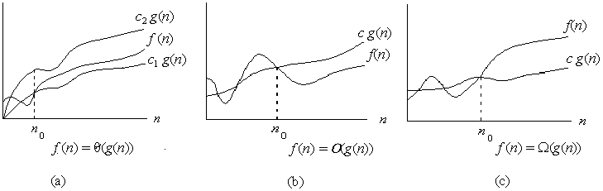
Big-O
Big-O, commonly written as O, is an Asymptotic Notation for the worst case, or ceiling of growth for a given function.
It provides us with an asymptotic upper bound for the growth rate of runtime of an algorithm.
Say f(n) is your algorithm runtime, and g(n) is an arbitrary time complexity you are trying to relate to your algorithm. f(n) is O(g(n)), if for some real constants c (c > 0) and n₀, f(n) <= c g(n) for every input size n (n > n₀).

Slide 24
Example
f(n)=10n+5 and g(n)=n. Show that f(n) is O(g(n)).
To show that f(n) is O(g(n)) we must show that constants c and no such that f(n) <=c.g(n) for all n>=no Or 10n+5<=c.n for all n>=no Try c=15. Then we need to show that 10n+5<=15n Solving for n we get: 5<5n or 1<=n. So f(n) =10n+5 <=15.g(n) for all n>=1. (c=15,no=1).

Slide 25
Example
f(n) = 〖𝟑𝒏〗^𝟐+4n+1. Show that f(n)=O(𝒏^𝟐).
4n <=4𝒏^𝟐 for all n>=1 and 1<=𝒏^𝟐 for all n>=1 〖3𝑛〗^2 +4n+1<=3𝒏^𝟐+4𝒏^𝟐+𝒏^𝟐 for all n>=1 〖3𝑛〗^2 +4n+1<=8𝒏^𝟐 for all n>=1 So we have shown that f(n)<=8𝒏^𝟐 for all n>=1 Therefore, f (n) is O(𝒏^𝟐) (c=8,k=1)

Slide 26
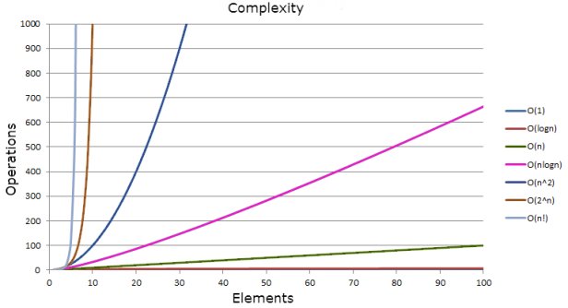
Big-o time complexity comparison
O(1) < O(log n) < O(√n) < O(n) < O(n log n) < O(n²) < O(n³)….. < O(2^{n}) < O(3^{n})…..< O(n^{n})

Slide 27
Growth-Rate Functions
O(1) Time requirement is constant, and it is independent of the problem’s size.
O(log₂n) Time requirement for a logarithmic algorithm increases slowly as the problem size increases.
O(n) Time requirement for a linear algorithm increases directly with the size of the problem.
O(n*log2n) Time requirement for a n*log2n algorithm increases more rapidly than a linear algorithm.
O(n²) Time requirement for a quadratic algorithm increases rapidly with the size of the problem.
O(n³) Time requirement for a cubic algorithm increases more rapidly with the size of the problem than the time requirement for a quadratic algorithm.
O(2ⁿ) As the size of the problem increases, the time requirement for an exponential algorithm increases too rapidly to be practical.

Slide 28
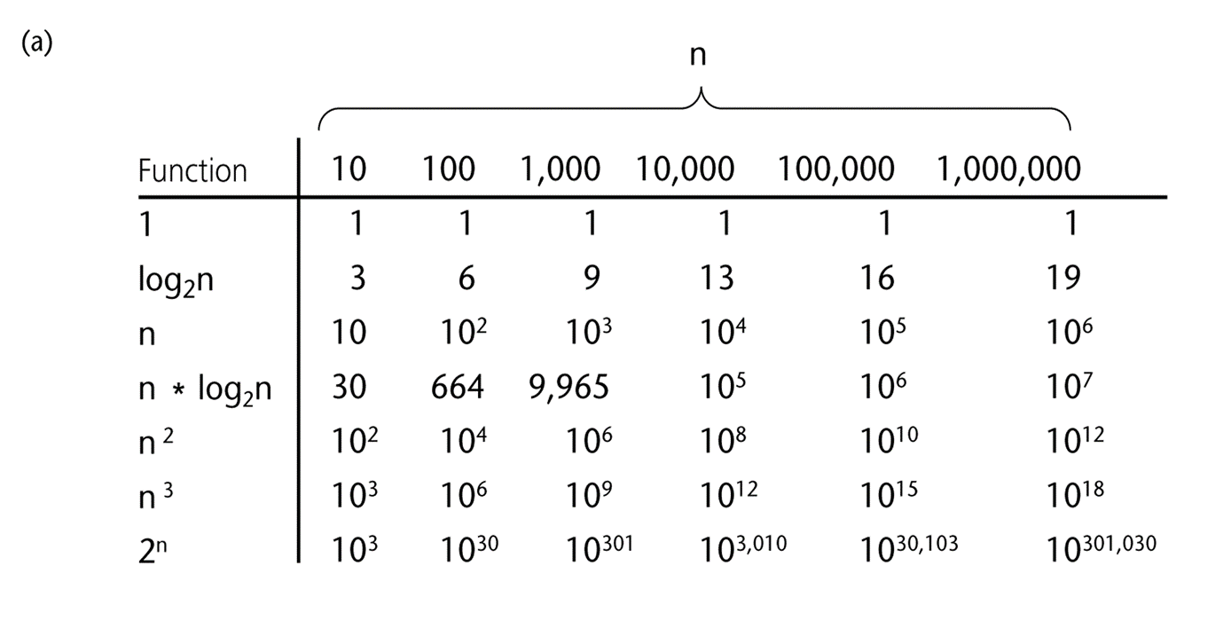
A Comparison of Growth-Rate Functions

Slide 29
Omega notation
Big-Omega, commonly written as Ω, is an Asymptotic Notation for the best case, or a floor growth rate for a given function.
It provides us with an asymptotic lower bound for the growth rate of runtime of an algorithm.
f(n) is Ω(g(n)), if for some real constants c (c > 0) and n0 (n0 > 0), f(n) is >= c g(n) for every input size n (n > n0)

Slide 30
Example
f(n) = 3n+2. Show that f(n)=Ω(n).
C=1 & n₀ >=1

Slide 31
Theta notation
Theta, commonly written as Θ, is an Asymptotic Notation to denote the asymptotically tight bound on the growth rate of runtime of an algorithm.
f(n) is Θ(g(n)), if for some real constants c1, c2 and n0 (c1 > 0, c2 > 0, n0 > 0), c1 g(n) is < f(n) is < c2 g(n) for every input size n (n > n0).
∴ f(n) is Θ(g(n)) implies f(n) is O(g(n)) as well as f(n) is Ω(g(n)).

Slide 32
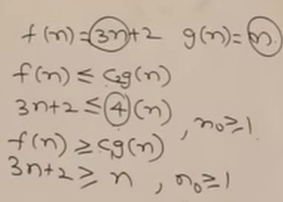
Example
f(n) = 3n+2. Show that f(n)= (n).

